Slide 1
realMLS
Data Conversion
October 2023

Slide 2
Alignment with RESO Standards
RESO’s mission is to create and promote the adoption and utilization of standards that drive efficiency throughout the real estate industry.
RESO alignment allows for searching across different MLS’s in the Coast 2 Coast MLS Data Share.

Slide 3
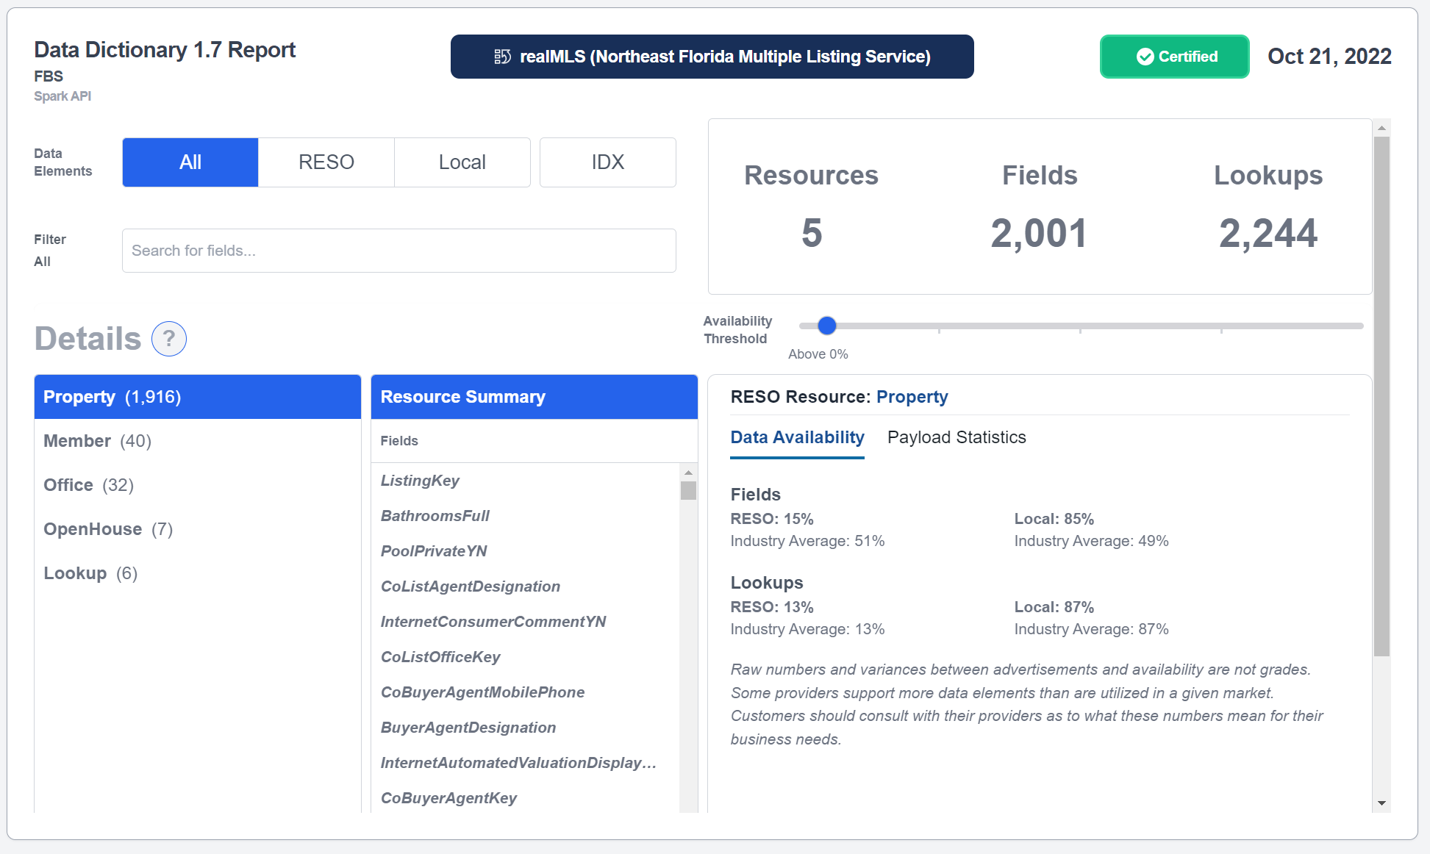

Slide 4
Examples REMOVED Fields:
"Regions"
-Each Region contains certain MLS Areas
-Region 1 = MLS Areas 011, 012, 013, 014, 015
-Saved Searches will be converted from Regions to MLS Areas
"Floor Plugs" underutilized.
"Tenant Pays Phone" and "Tenant Pays Long Distance" - OLD
"Dining"
-No longer separate details such as “Separate Dining Room”
-Moved to “Room” detail
-Any details removed will be appended to Public Remarks section.
Examples NEW Fields:
“Patio and Porch Features”
-Covered, Screened, etc.
“Views”
-Ocean View, Golf Course View, etc.
“Tax Year” and “Tax Annual Amount”
-Pulling in from MMT
“Direction Faces”
-The direction the front of the
property faces
Example CHANGED Fields:
“Navigable to Ocean Y/N” will now be located under “Waterfront Features” as the option Navigable Water
“Contingent” Status will be converted to “Active Under Contract” Status.
“Duplex”, “Triplex”, & “Quadruplex” are no longer Residential and will be moved to “Residential Income”.

Slide 5
Listings and Comparables
Saved Searches
Contacts
Customer Portals
Subscriptions
Subscription(s) Opt In Report
Saved Closing Cost Estimates
Custom email templates
Custom Dashboards
Saved CMAs (up to 3 years, PDF format only)
My Profile
Customizations That Will Need to be Recreated by Member
Customizations Being Converted and Moved Over
Custom Map Overlays
Custom Quick Search Templates
Custom Reports
Custom Sorts
Custom Views
Customized Contact Lists
Daily Hot Sheet Settings
Default Map Setting
General Preferences
General Settings
Hot Sheet Settings
Incomplete Listings
Listing Collections
My Exports
My Market
My Market Area
My Sent Email History
Presentations

Slide 6
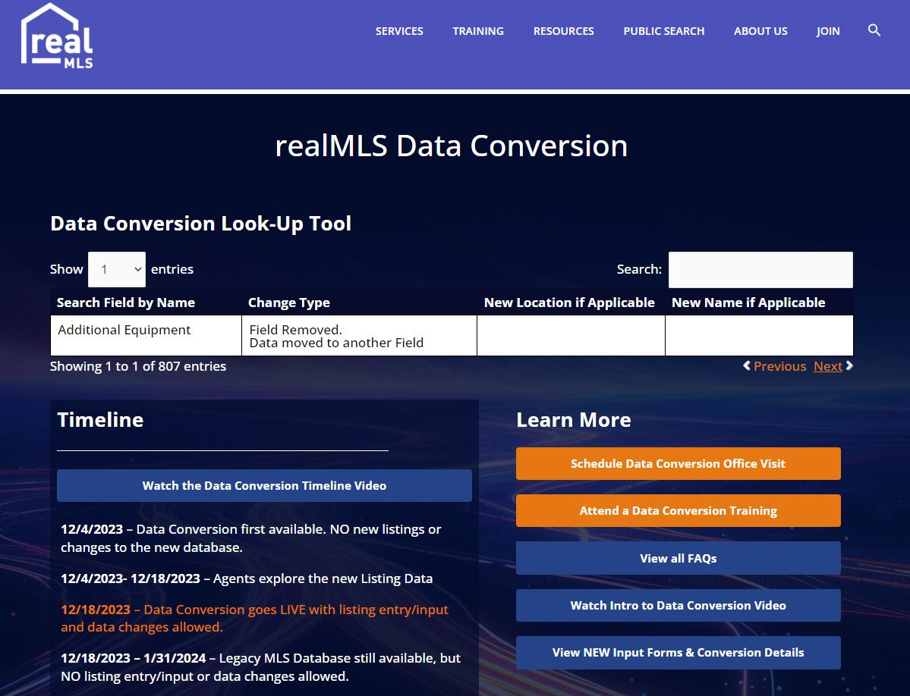

Slide 8
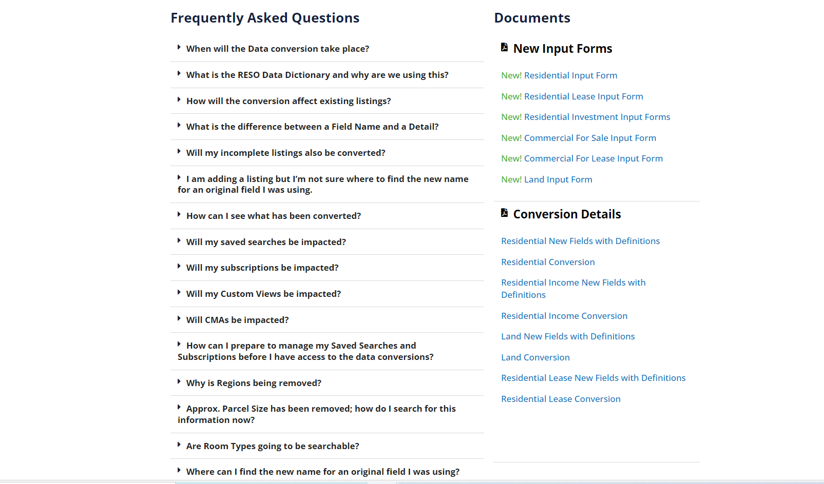

Slide 9
First Look! Search tool!

Slide 10
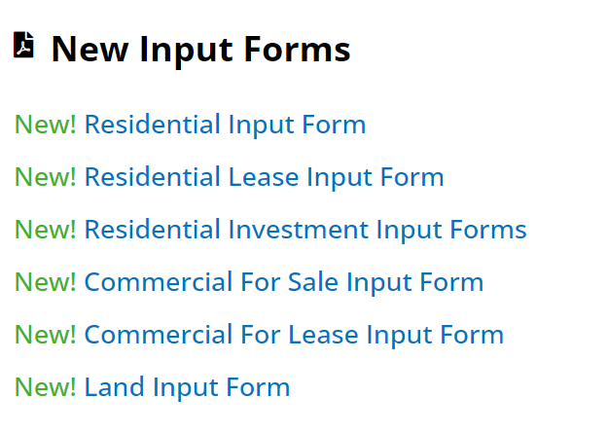
Updated Data Input Forms

Slide 11
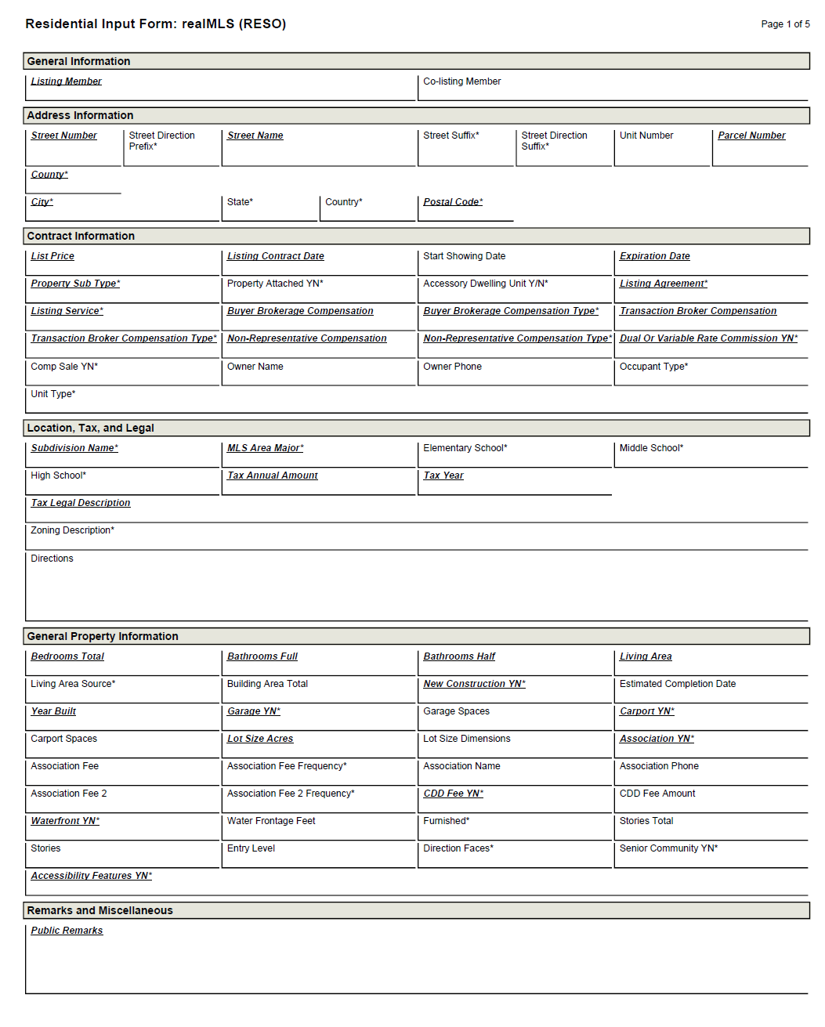
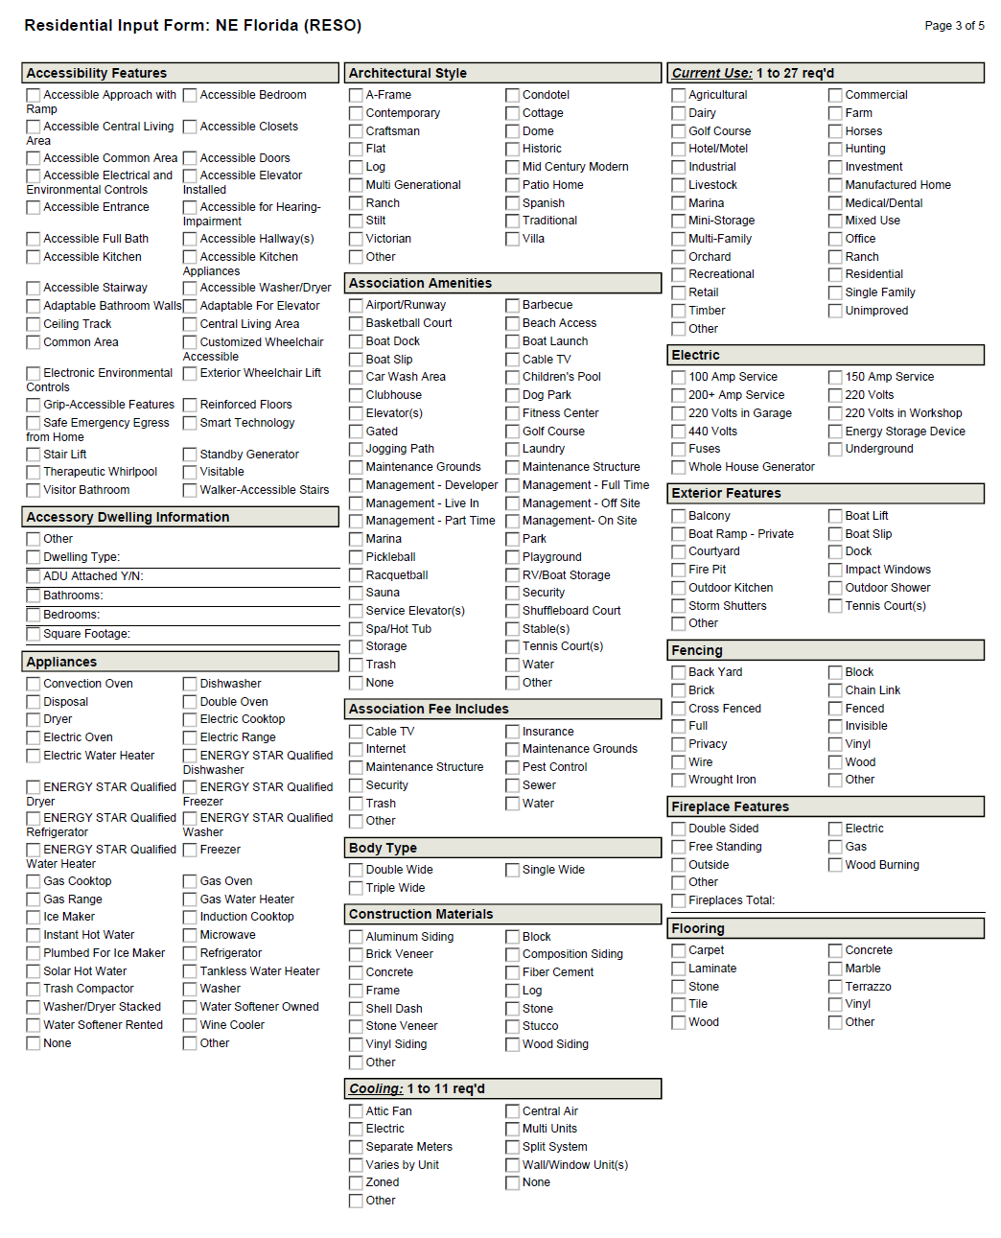

Slide 12
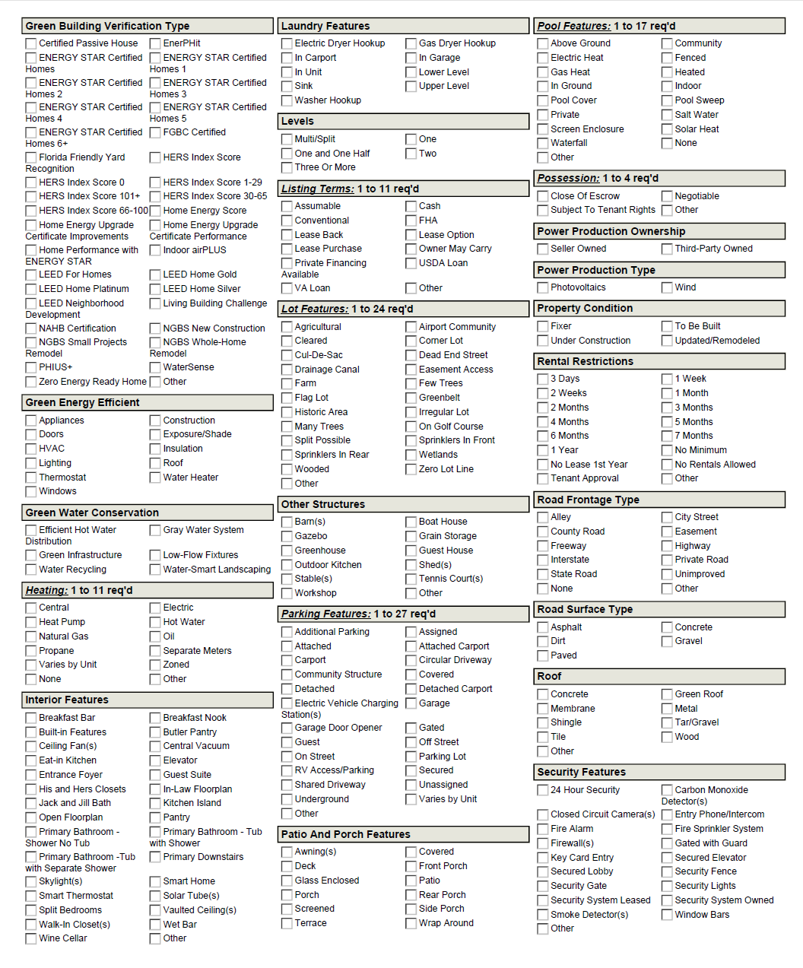
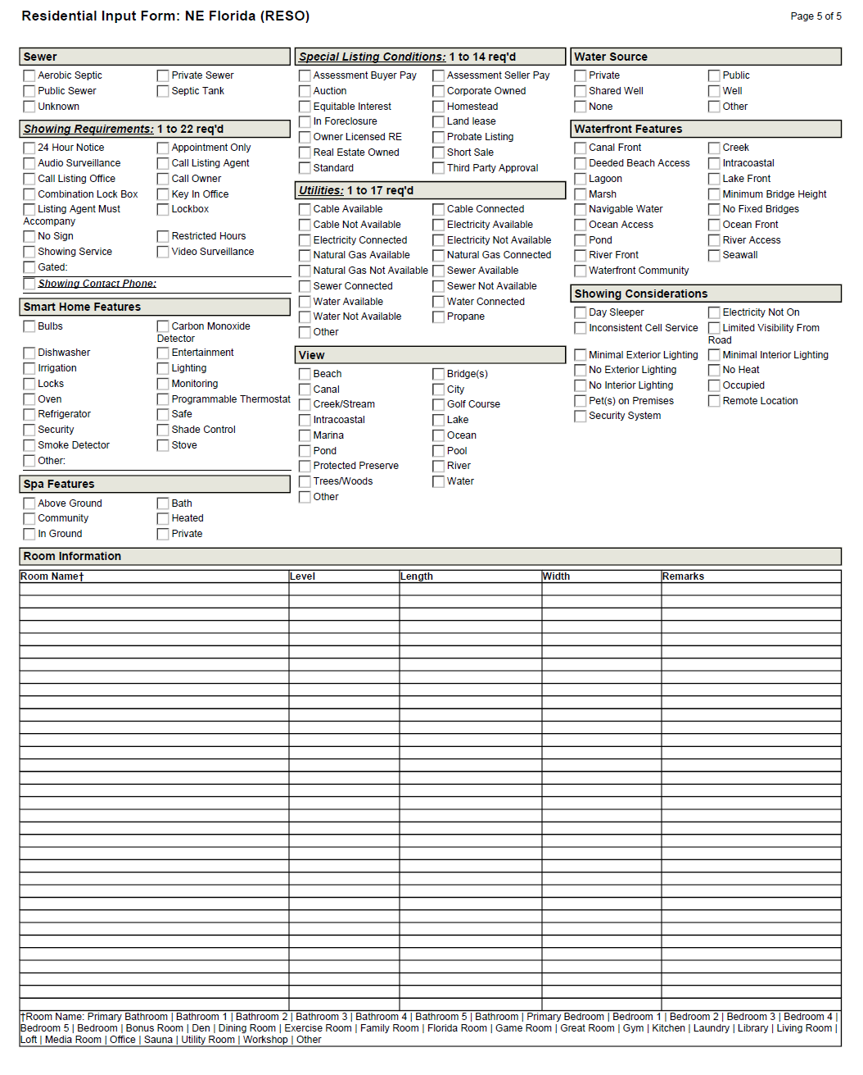

Slide 13
www.realMLS.com/data-conversion
Notes:
Here is a QR code you can scan which will take you to www.Coast2CoastMLSDataShare.com There you will find a joint letter to our Participant Brokers, an FAQ and other information about the data share effort. [Advance the slide]

Slide 15
Notes:
December 4 New Database will be available. Explore. Listings into LEGACY DB.
December 18 Switch to New Database. Listings into New DB. No New or Changes into Legacy DB.
Legacy DB will be available through the New Year for reference and to ensure full conversion of Saved Searches, Contacts, CMA, etc.

Slide 16
www.Coast2CoastMLSDataShare.com
Notes:
Here is a QR code you can scan which will take you to www.Coast2CoastMLSDataShare.com There you will find a joint letter to our Participant Brokers, an FAQ and other information about the data share effort. [Advance the slide]

Slide 17
Thank You!
realMLS
Support@realMLS.com
www.realMLS.com

