Slide 1
New Product!
April 9, 2024

Slide 2
realMLS presents LAUNCH
When you log in to Flexmls you will be brought the LAUNCH Dashboard.

Slide 3
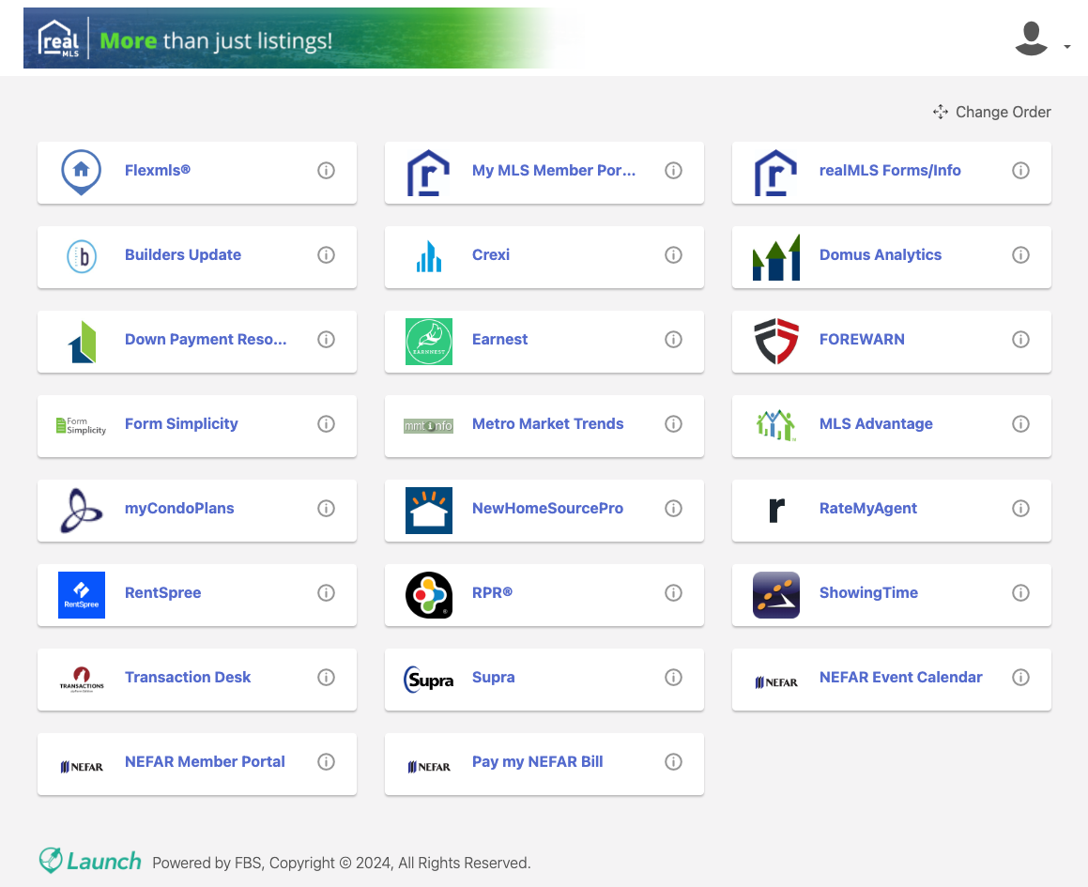
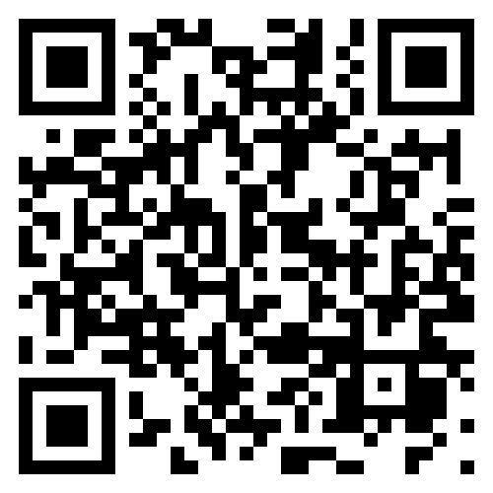
The Launch Dashboard now provides easy access to all the products included with your membership in realMLS.
Launch is fully compatible with mobile devices and is fully customizable.
For more information watch our preview video here.

Slide 4
THANK YOU!
realMLS
7801 Deercreek Club Rd. Jacksonville Fl. 32256
Support 904.281.1400 Ext 1603
Support@realMLS.com
realMLS.com

